Slide 1

LifeScan Mobile Application
Aidan O’Connor
T00095576

Slide 2
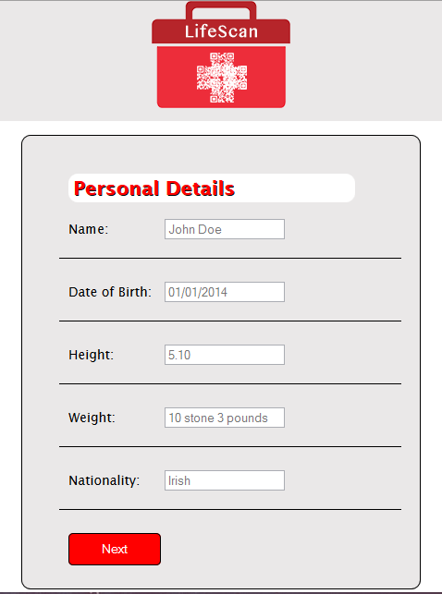
Personal Details

Slide 3
Pseudo Code
IF Next button is clicked:
CALL FUNCTION Validate Personal Details to check if a text field is NULL
IF a text field is NULL
Alert user which text field they need to fill in
ELSE
Display Contact Details Screen

Slide 4
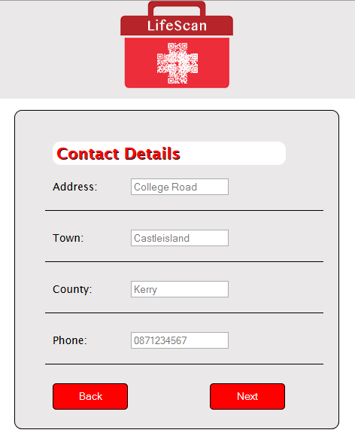
Contact Details

Slide 5
Pseudo Code
IF Next button is clicked:
CALL FUNCTION Validate Contact Details to check if a text field is NULL
IF a text field is NULL
Alert user which text field they need to fill in
ELSE
CALL FUNCTION to display Medical Information Screen
IF Back button is clicked
CALL FUNCTION Back to Personal Details:
SET Contact Details screen to hidden
SET Personal Details Screen to display

Slide 6
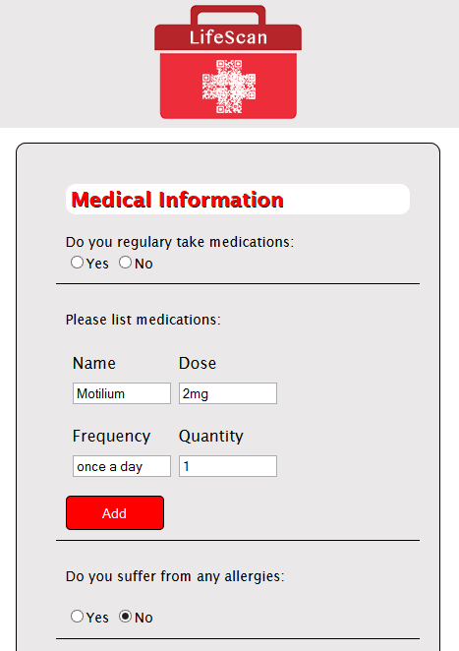
Medical Information

Slide 7
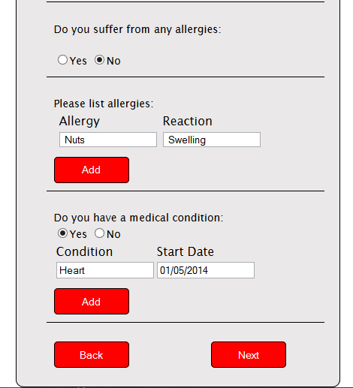
Medical Information

Slide 8
Pseudo Code
IF Next button is clicked:
CALL FUNCTION Validate Medical Information to check if a text field is NULL
IF a text field is NULL
Alert user which text field they need to fill in
ELSE
CALL FUNCTIONS Get Medication List, Allergy List, Medical Condition List
FOR LOOP through each array and RETURN results
CALL FUNCTION to display Emergency Contacts Screen
IF Back button is clicked
CALL FUNCTION Back to Medical Information:
SET Medical Information Screen to hidden
SET Emergency Contacts screen to display
IF ADD Medication is clicked:
Append 2 columns and 2 Rows to medications table
IF ADD Allergy is clicked:
Append a row and two columns to allergies table
IF ADD Medical Condition clicked:
Append a row and two columns to medical conditions table

Slide 9
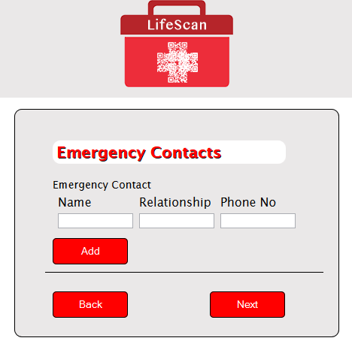
Emergency Contacts

Slide 10
Pseudo Code
IF Next button is clicked:
CALL Function Validate Emergency Contact Details to check if a text field is NULL
IF a text field is NULL
Alert user which text field they need to fill in
ELSE
CALL FUNCTION Get Emergency Contacts List
FOR LOOP through the array and RETURN results
CALL FUNCTION to display Physician Details Screen
IF Back button is clicked
CALL FUNCTION Back to Medical Information:
SET Emergency Contacts Details screen to hidden
SET Medical Information Screen to display
IF ADD is clicked:
Append a row and three columns to emergency contact table

Slide 11
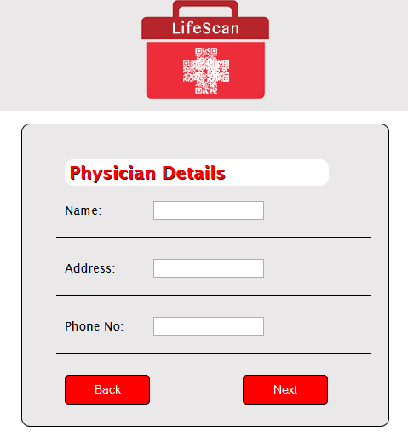
Physician Details

Slide 12
Pseudo Code
IF Next button is clicked:
CALL FUNCTION Validate Physician Details to check if a text field is NULL
IF a text field is NULL
Alert user which text field they need to fill in
ELSE
Call function to display Hospital Details Screen
IF Back button is clicked
CALL FUNCTION Back to Emergency Contacts:
SET Physician Details screen to hidden
SET Emergency Contacts screen to display

Slide 13
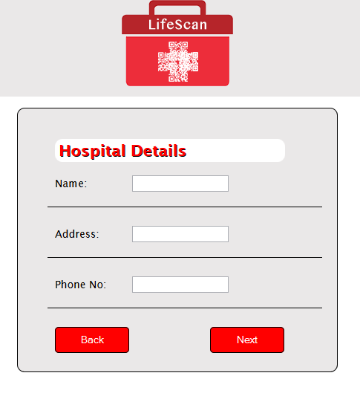
Hospital Details

Slide 14
Pseudo Code
IF Next button is clicked:
CALL FUNCTION Validate Hospital Details to check if a text field is NULL
IF a text field is NULL
Alert user which text field they need to fill in
ELSE
CALL FUNCTION to display Pharmacy Details Screen
IF Back button is clicked
CALL FUNCTION Back to Physician Details:
SET Hospital Details screen to hidden
SET Physician Detail screen to display

Slide 15
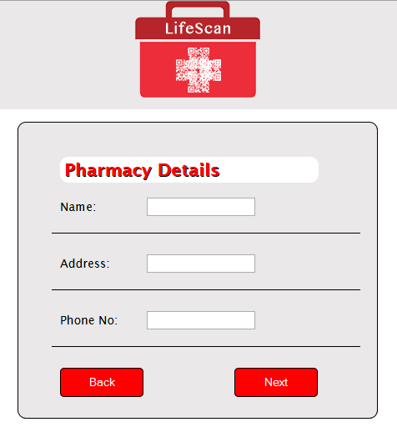
Pharmacy Details

Slide 16
Pseudo Code
IF Next button is clicked:
CALL FUNCTION Validate Pharmacy Details to check if a text field is NULL
IF a text field is NULL
Alert user which text field they need to fill in
ELSE
CALL FUNCTION to display Health Insurance Details Screen
IF Back button is clicked
CALL FUNCTION Back to Physician Details:
SET Pharmacy Details screen to hidden
SET Hospital Details screen to display

Slide 17
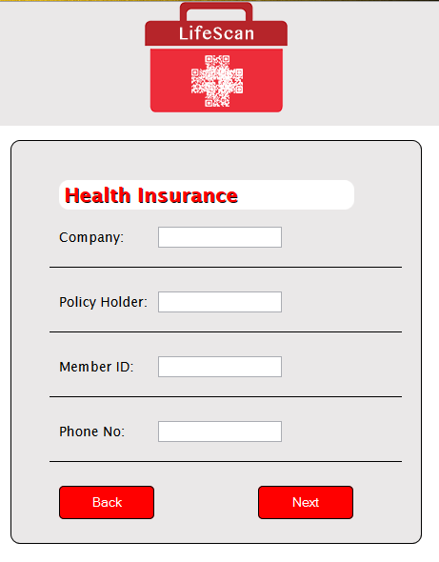
Health Insurance Details

Slide 18
Pseudo Code
IF Next button is clicked:
CALL FUNCTION Validate Health Insurance Details to check if a text field is NULL
IF a text field is NULL
Alert user which text field they need to fill in
ELSE
CALL FUNCTION to display Generate QR Code Screen
IF Back button is clicked
CALL FUNCTION Back to Pharmacy Details:
SET Health Insurance Details screen to hidden
SET Pharmacy Details screen to display

Slide 19
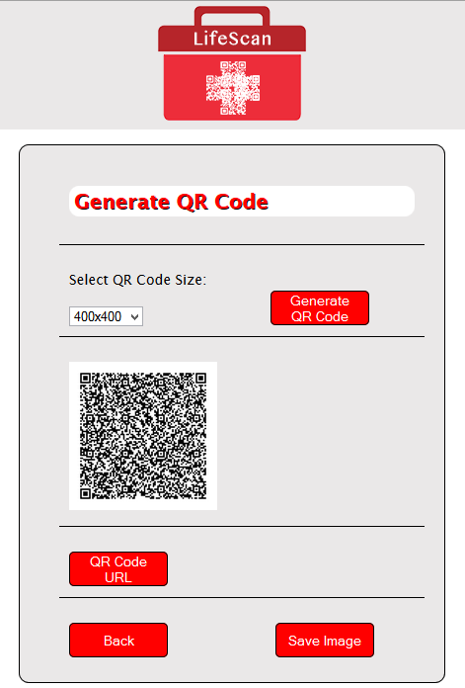
Generate QR Code

Slide 20
Pseudo Code
IF Generate QR code button is clicked:
CALL FUNCTION Generate QR code:
SET variable QRText to text field values user has entered
SET Image Size to selected user value
Append QRText and Image Size to Google chart url
SET QR image attribute to Google chart URL
IF Back button is clicked
CALL FUNCTION Back to Health Insurance Details:
SET Generate QR Code screen to hidden
SET Health Insurance Details screen to display

